Slide 1
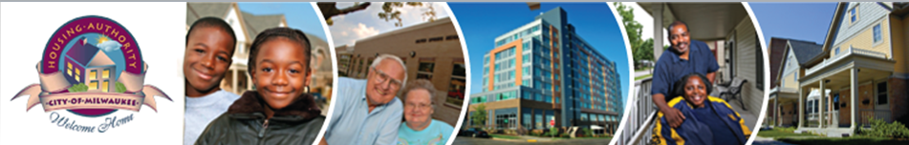
Rental Assistance Demonstration (RAD) Opportunity
Housing Authority of the City of Milwaukee
Resident Information Meeting
July 13, 2015

Slide 2

“The affordable housing crisis is growing. RAD is part of the solution.”
HUD Secretary, Julian Castro

Slide 3
What is RAD?
The Rental Assistance Demonstration (RAD) was created by HUD in 2012 in order to give public housing authorities a powerful tool to preserve and improve affordable housing and to address the large backlog of needed repairs.
Under RAD, units change from public housing to project-based Section 8 voucher (rent assistance) under a long-term contract between HACM and HUD. This ensures that the units remain permanently affordable to low-income households.
Residents continue to pay no more than 30% of their income for rent.

Slide 4
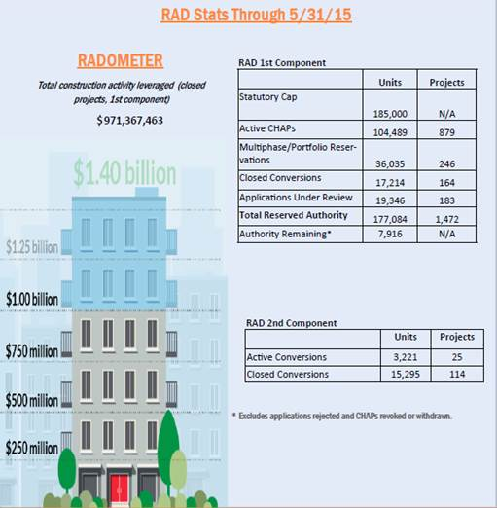
Nationwide , housing authorities have already applied for and reserved a total of 177,084 housing units in 1,472 developments

Slide 5
Why is RAD needed?
Across the country and here in Milwaukee, the public housing inventory is aging, becoming more obsolete and has an increasing backlog of needed repairs.
At the same time, Congress has not provided enough funding for public housing to operate buildings and fix these capital needs. Capital funding has declined 24% over the past decade and operating subsidy has decreased significantly in recent years.

Slide 6
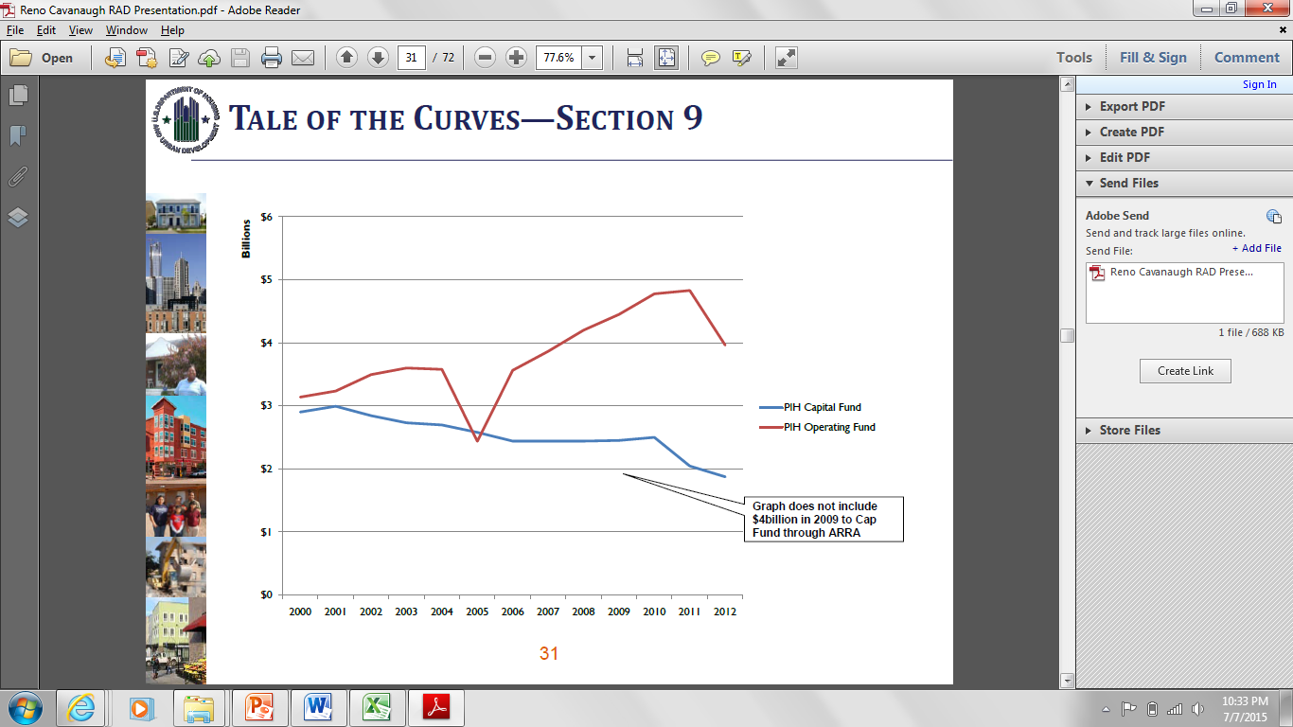
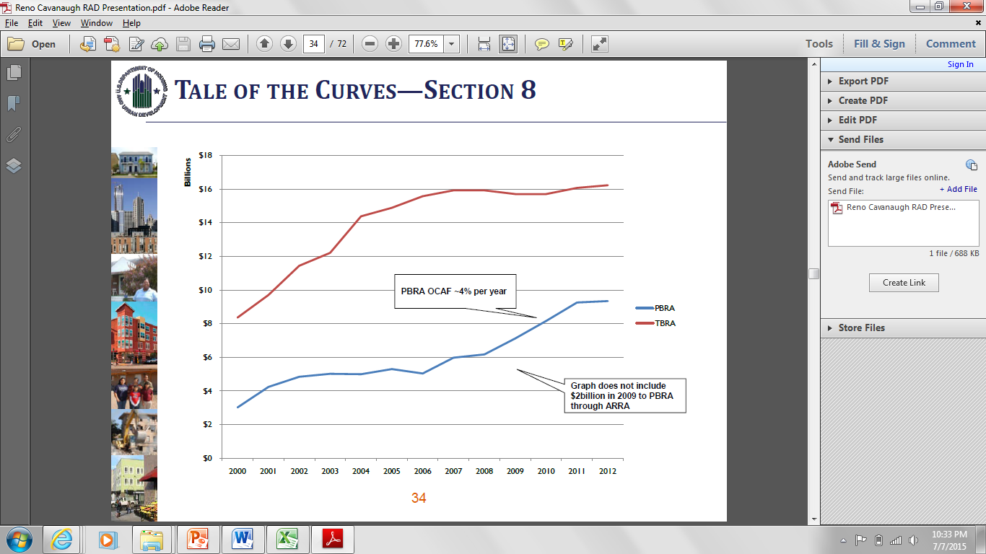
Funding from HUD
Public Housing Funding Curve
Section 8 Funding Curve

Slide 7
Why HACM is Pursuing RAD
HACM’s current backlog of Capital Needs is over $113 million
With existing capital fund levels it would take over 37 years to repair HACM’s existing backlog
The Housing Authority is only reimbursed from HUD for $.84 of every $1.00 of eligible public housing expenses. In 2014, the Housing Authority had to use more than $6.5 million of its own cash reserves to subsidize public housing.
Proposed 2016 HUD funding calls for another 10% cut in funds to maintain and repair public housing.

Slide 8
RAD Advantages
RAD will provide defined and more secure project subsidy from HUD.
RAD will also allow housing authorities like HACM to borrow money and use Low Income Housing Tax Credits and other financing to renovate and repair our properties.

Slide 9
RAD Impact on Residents
Will the rent residents pay change as a result of RAD?
Residents will continue to pay no more than 30% of adjusted income. If RAD conversion results in a resident’s rent going up by more than 10% or $25.00 per month the increase will be phased in over a 3 to 5 year period. This would only likely be possible if a resident is at a high enough income to pay flat rents.
Will residents have to sign a new lease?
  Yes. However, current public housing residents will not be rescreened, or face other income eligibility criteria or income targeting provisions. If you are lease compliant before RAD conversion, you cannot be displaced.
If I make too much money, will I have to move?
No, you cannot be forced to move. Normally, there are income limits under Section 8. However, under a RAD conversion, existing public housing residents that would be over that income limit would be able to stay living in the development with a voucher.

Slide 10
RAD Impact on Residents
Residents may still participate in Family Self- Sufficiency and Resident Opportunities and Self-Sufficiency programs.
Resident councils would continue to exist and would continue to receive resident participation funding.

Slide 11
Significant Modernization and Renovation
As part of RAD conversion, HACM will pursue various funding sources including Low Income Housing Tax Credits to do the needed renovations at every property
A design team will work with residents and property managers to develop a renovation plan for each community
Renovation would not begin until 2017 and would be done in phases over a number of years.

Slide 12
Relocation
If major renovations are needed, residents may need to be temporarily relocated for renovation
HACM is responsible for all relocation expenses
Residents will be offered a choice to:
  (1) temporarily relocate using a Housing Choice Voucher or to another public housing development, returning back after the repairs are completed; or
  (2) to relocate permanently using a Housing Choice Voucher

Slide 13
Why is this happening now and so quickly?
On June 15, 2015, HUD issued regulations that will change the way RAD applications are prioritized by HUD. If HACM does not submit an application before July 15, we will fall under the new regulations which would mean that we may be at the bottom of HUD’s priority list for RAD conversion.
This is not set in stone. This is like submitting a letter of interest or a reservation. We can withdraw from consideration at any time until the end of the process.
As we continue to review RAD, we will continue to meet with residents to keep you informed and to solicit resident input in the process.

Slide 14
Questions and
Answers

